Slide 1
CSE 486/586 Distributed Systems Introduction
Steve Ko
Computer Sciences and Engineering
University at Buffalo

Slide 2
Welcome to CSE 486/586
Why do you want to take this course?
Some positive feedback of this course…
“(CSE 486/586) didn't only helped with understanding the concepts involved, but have also always given me something cool and interesting to talk about in interviews.”
“I am actually learning new things.”
Some negative feedback of this course…
“Projects are a bit too much on the difficult side.”
“The midterm came almost out of nowhere.”
Are you ready? ;-)

Slide 3
Building a Distributed System
“The number of people who know how to build really solid distributed systems…is about ten”
Scott Shenker, Professor at UC Berkeley
The point: it’s hard to build a solid distributed system.
So, why is it hard?...but first of all…

Slide 4
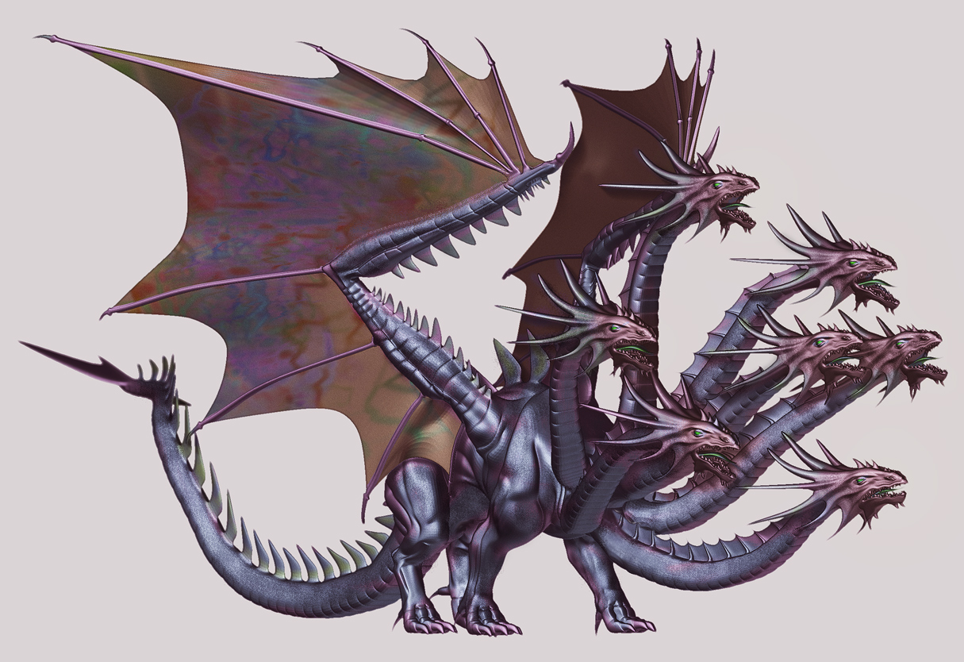
What is a Distributed System?

Slide 5
What is a Distributed System?
A distributed system is a collection of entities with a common goal, each of which is autonomous, programmable, asynchronous and failure-prone, and which communicate through an unreliable communication medium.
This will be a working definition for us.

Slide 6
Why Is It Hard to Build One?
Scale: hundreds or thousands of machines
Google: 4K-machine MapReduce cluster
Yahoo!: 4K-machine Hadoop cluster
Akamai: 70K machines distributed over the world
Facebook: 60K machines providing the service
Hard enough to program one machine!
Dynamism: machines do fail!
50 machine failures out of 20K machine cluster per day (reported by Yahoo!)
1 disk failure out of 16K disks every 6 hours (reported by Google)
What else?
Concurrent execution, consistency, etc.

Slide 7
OK; But Who Cares?
This is where all the actions are!
What is the two biggest driving forces in the computing industry for the last 5 years?
It’s the cloud!
And smartphones!
They are distributed!
Now --- it’s all about distributed systems!
Well…with a bit of exaggeration… ;-)

Slide 8
OK, Cool; How Am I Going to Learn?
Textbook
Main: Distributed Systems: Concepts and Design, 5th Edition (Coulouris, Dollimore, Kindberg, Blair)
Optional: Distributed Systems: Principles and Paradigms, 2nd Edition, (Tanenbaum, Van Steen)
Prerequisites
Minimum: CSE 250 Data Structures and Algorithms
Ideal: Basic networking concepts (TCP/IP, routing), basic OS concepts (processes, threads, synchronization, file systems), systems programming (pthread, socket)
Lectures
(Non-graded) HW assignments
Programming assignments
Exams

Slide 9
What Am I Going to Build?
A “starter” project: project 0
A distributed key-value storage (based on Amazon Dynamo) on Android in 3 stages: project 1 ~ project 3
For each project, submit a solution/design document as well as code
Individual submission

Slide 10
Important Policies
Late submission: 20% penalty per day
Regrading
If requested, the entire work will be regraded
No “I”
No makeup exam
No grade negotiation

Slide 11
Academic Integrity Policies
Academic integrity: exams, HW, and code
Copying others’ code: no
Copying from other sources (the Web, books, etc.): get permission
Exceptions: http://developer.android.com (copy freely, but mark clearly that you copied)
http://stackoverflow.com (generally OK to see how things get done; but do not copy and paste.)
If found, the incident will be reported to the university
Will use an automatic similarity checker.
When similar submissions are found, both will get F for the entire semester.
Please be careful when using an online code repository, e.g., GitHub, BitBucket, etc.

Slide 12
How Can I Reach the Teaching Staff?
Steve: 304 Davis
Lectures (MWF 3:00pm-3:50pm)
Office hours (MWF 4pm-5pm)
TAs
(Tentative) Recitations: M (10:00 – 10:50) & F (2:00 – 2:50) @ Baldy 106
Office hours: generally 3 hours for each and every weekday will be covered.
Please do not expect that the TAs will stay more than 3 hours.
Use Piazza (http://piazza.com/class), instead of email, mailing list, blog, etc.

Slide 13
What Exactly Am I Going to Learn? Distributed Systems 10 Questions!
Course goal: answering 10 questions on distributed systems
At the end of the semester, if you can answer only 10 questions about distributed systems, you’ll probably get an A.
Easy enough!
What are those questions?
Organized in 6 themes
1~2 questions in each theme
A few (or several) lectures to answer each question

Slide 14

What Exactly Am I Going to Learn?
Introducing…
Hydie!

Slide 15
Theme 1: Hint
What’s up?
Hey!

Slide 16
Theme 1: Communications
Q1: how do you talk to another machine?
Networking basics
Q2: how do you talk to multiple machines at once?
Multicast
Q3: can you call a function/method/procedure running in another machine?
RPC

Slide 17
Theme 2: Hint
I thought I was doing it…
I’m shaking my tail.
What? I’m doing it too!

Slide 18
Theme 2: Concurrency
Q4: how do you control access to shared resources?
Distributed mutual exclusion, distributed transactions, 2-phase commit, etc.

Slide 19
Theme 3: Hint
I want to shake my tail.
OK
No, I don’t want to.
No way!

Slide 20
Theme 3: Consensus
Q5: how do multiple machines reach an agreement?
Time & synchronization, global states, snapshots, mutual exclusion, leader election, paxos
Bad news: it’s impossible!
The impossibility of consensus

Slide 21
Theme 4: Hint
Who has a brain?
I do.
I don’t.

Slide 22
Theme 4: Storage Management
Q6: how do you locate where things are and access them?
DHT, DFS

Slide 23
Theme 5: Hint
I have a feeling that something went wrong…
zzz…

Slide 24
Theme 5: Non-Byzantine Failures
Q7: how do you know if a machine has failed?
Failure detection
Q8: how do you program your system to operate continually even under failures?
Replication, gossiping

Slide 25

Theme 6: Hint
We’re under attack!

Slide 26
Theme 6: Byzantine Failures
Q9: how do you deal with attackers?
Security
Q10: what if some machines malfunction?
Byzantine fault tolerance

Slide 27
Acknowledgements
These slides heavily contain material developed and copyrighted by Indranil Gupta at UIUC.
The material was originally developed for courses CS425/CSE424/ECE428 at UIUC.

